Slide 1
Domain Driven Design
Diane Wilson
Fujifilm Medical Systems

Slide 2
Domain Driven Design
Part 4: More on Tactical Design and Implementation

Slide 3
Assumptions
Compatible with agile processes
.NET centric

Slide 4
Domain Driven Design
Tackling Complexity in real world, complex systems
Business experts and developers on one team
Ubiquitous language
Domain model based in the language of the business
Design and code using domain model and ubiquitous language
One Team, One Language, One Model

Slide 5
Domain Driven Design Patterns
Strategic Patterns
Domain
Core domain
Subdomain
Generic subdomain
Bounded context
Context map
Tactical Patterns
Domain Entities
Value Objects
Aggregates
Domain Services
Domain Events
Modules

Slide 6
From Bounded Context to Implementation
Bind Core Domain or Subdomain to code
Bounded Context exists within a single subdomain
Bounded Context sets scope for Ubiquitous Language
Context map defines interfaces and relationships between contexts
Visual Studio projects map to Bounded Context

Slide 7
Domain Entities
Unique identity
Mutable
Intrinsic characteristics – attributes and behaviors identified in the domain model
Intention revealing interfaces
Constructors provide identity and invariants
Reject undue influence of data model leakage

Slide 8
Value Objects
Measures, quantifies, describes
Not unique
Immutable
Conceptual whole – related attributes as an integral unit
Completely replaceable
Can be compared using Value equality
Provides side-effect-free behaviors
Preferable to entities

Slide 9
Some Uses for Value Objects
Integrating across domain boundaries
Downstream context captures data from upstream as Value Objects (anti-corruption layer)
Static characteristic captured from other data
“User” is an aggregate, but a “Moderator” is a static role for a user
Standard Types
Phone number as “home”, “work”, “mobile”, or “other”
Currency types
Standard Types commonly reside in a separate Bounded Context from models that consume them
In native Context, Standard Types may be Entities with their own life cycle

Slide 10
Value Objects or Entities?
Reject undue influence of data model leakage
Am I modeling a thing in the domain, or does it measure, quantify, or describe?
If describing an element of the domain, must this model concept possess all or most of the value characteristics outlined previously?
Am I considering the use of an Entity only because the underlying data model must store the domain model object as an entity?
Am I using an Entity because the domain model requires unique identity, I care about individual instances, and I must manage a continuity of change over the object’s life cycle?
If your answers are “Describes, Yes, Yes, and No”, use a Value Object
Persistence is about storage, not your domain model
The data model should be subordinate to the domain model

Slide 11
Domain Driven Testing
Testing for Domain behaviors

Slide 12
Aggregates
Is it just a cluster or graph of related objects?
What are the limits on size?
If one aggregate references another, can you…
Navigate deeply?
Modify other aggregates?
What about invariants and consistency?

Slide 13
Rules
Model True Invariants in Consistency Boundaries
Design Small Aggregates
Don’t Trust Every Use Case
Reference Other Aggregates by Identity
Make aggregates work together through Identity references
Model navigation
Scalability and distribution
Use Eventual Consistency Outside the Boundary
“Whose Job Is This?”

Slide 14
Reasons to Break the Rules
User Interface convenience
Lack of Technical Mechanisms
Global Transactions
Query Performance

Slide 15
So, What Does All This Mean?
Invariant: A Business rule that must always be consistent
Transactional consistency
Eventual consistency
An aggregate’s boundary is its transactional consistency boundary
Consistency outside the boundary is irrelevant to the aggregate
The Bounded Context should modify only one aggregate per transaction
Aggregates are about consistency boundaries, not object graphs

Slide 16
What Is a “Small” Aggregate?
Limited by transactional consistency
Limited by scalability and performance
Rely on lazy loading in your persistence layer
Be aware of memory constraints
Watch out for 1-to-many relationships. They grow!
Root entity and those attributes, Value Objects, and additional entities that are required for consistency
Do additional entities present consistency problems?
Are multiple users accessing the same entities at the same time?

Slide 17
How Should Aggregates Interact?
Aggregates may hold references to other aggregates
Referenced aggregate is outside consistency boundary
Only modify one aggregate within a single transaction
Referenced aggregates need eventual consistency
Use lazy loading by identity
Use repository or Domain Service to look up dependencies before invoking Aggregate behavior
Reference by identity improves scalability

Slide 18
Eventual Consistency
Any rule that spans Aggregates will not be expected to be up-to-date at all times.
Delayed consistency is common in business
Domain Events provide for asynchronous subscribers
CQRS architecture pattern supports eventual consistency
“Whose Job Is It?”
Current user – use transactional consistency
Other users, or system – use eventual consistency

Slide 19
Breaking the Rules
User Interface presents a view of concurrent changes
Batch processing of aggregates, as long as consistency matches user expectations
Lack of Technical Mechanisms
No support for messaging, timers, or threading
User-aggregate affinity
Global Transactions
Two-phase commits are slow and expensive
Performance
Sticking to the rules will benefit your project

Slide 20
Insight Through Discovery
Estimate Aggregate cost
Rethink your design, and refactor
Design for common usage scenarios
Memory considerations
Explore alternative designs
Implement eventual consistency

Slide 21
Implementation
Root Entity with Unique Identity
Prefer Value Object parts
Access to all properties must go through the aggregate
Tell, Don’t Ask
An object should be told what to do
Law of Demeter
Any method may invoke methods only on the following
Itself
Any parameter passed to it
Any object it instantiates
Self-contained parts that it can directly address
Avoid Dependency Injection into Aggregates
Repositories
Domain Services

Slide 22
Domain Services
What a Domain Service is
Any process or transformation in the domain that is not a natural responsibility of an Aggregate, Entity, or Value Object
Stateless
Fine grained
Clearly expressed in terms of the Ubiquitous Language
What is it not?
Service-Oriented Architecture
Remote Procedure Call
Middleware
Application Service

Slide 23
Make Sure You Need a Service
Use only if circumstances fit
Significant business process
Transform a domain object from one composition to another
Calculate a Value requiring input from more than one domain object
Consider using a Separated Interface, Dependency Inversion, or a Factory

Slide 24
Domain Events
Model Aspects
Something happened that domain experts care about
Model that activity in the domain as a series of discrete events
Each event is a domain object

Slide 25
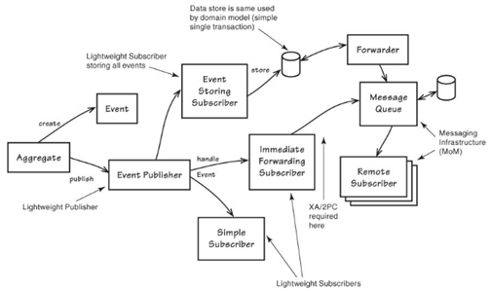
Domain Event Handling

Slide 26
Modeling Events
Name events and properties based on the Ubiquitous Language
Name is based on the event cause, having happened in the past
Follows successful completion of an operation
Implement as a Value Object
Time stamp (“occurred on”)
Entity and aggregate IDs
Related data
Immutable
Unique identity may be useful for external consumers

Slide 27
Publishing Events
Publishing events is distinct from responding to events
Middleware has no awareness of domain model
Publishing is a service
Event consumers are asynchronous
Event consumption results in eventual consistency

Slide 28
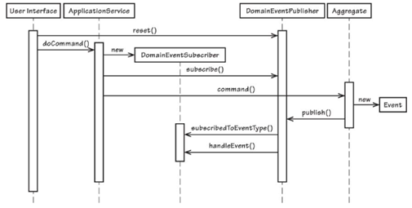
Event Publishing Flow

Slide 29
Subscription and Consumption of Events
Publish/Subscribe
Observers
Messaging components
RabbitMQ, NServiceBus, Azure Service Bus, Akka
RESTful services
Event Store

Slide 30
Next Month?

